Slide 1
What is Ensemble Learning
Ensemble learning is a machine learning technique where multiple models (learners) are combined to solve a problem and improve performance compared to a single model.
Key Idea: 'Many weak models together can make a strong model.'

Slide 2
Why Use Ensemble Learning
1. Improved Accuracy
2. Robustness
3. Versatility

Slide 3

Types of Ensemble Learning
1. Bagging (Bootstrap Aggregating):
Trains multiple models independently on different subsets of the data.
Example: Random Forest
2. Boosting:
Trains models sequentially, each focusing on correcting the errors of the previous ones.
Example: AdaBoost, LG Boosting, XG Boosting
3. Stacking:
Combines predictions from multiple models using a meta-model.

Slide 4
What is Boosting
Boosting is an ensemble learning technique that combines the predictions of several base estimators (usually weak learners) to improve robustness and accuracy.
Key Idea: Sequentially train models, each focusing on correcting the errors of the previous ones.

Slide 5
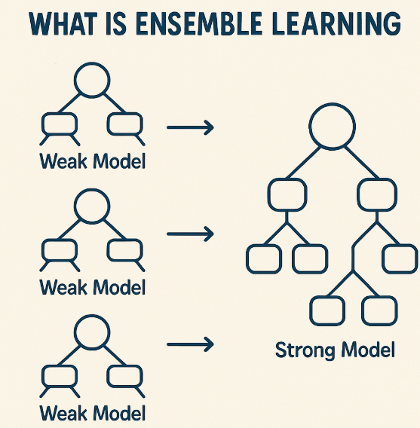
AdaBoost(Adaptive Boosting)
1. Initialize weights for all training samples.
2. Train a weak learner (e.g., decision stump).
3. Evaluate errors and update weights.
4. Repeat steps 2-3 for a set number of iterations.
5. Final prediction is a weighted sum of all weak learners.

Slide 6
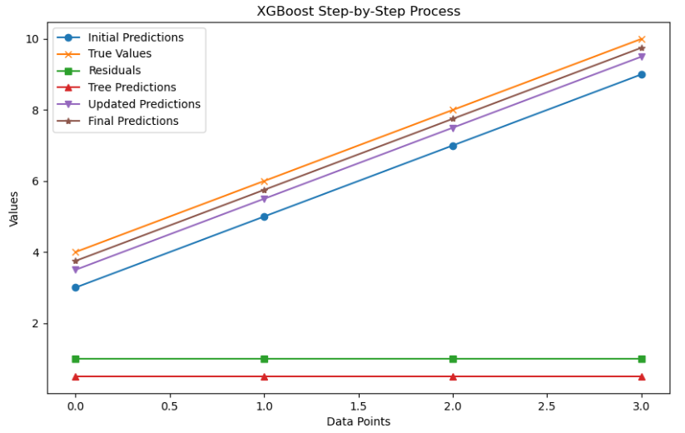
XGBoost(Extreme Gradient)
It is an advanced implementation of the gradient boosting algorithm, designed to be Highly efficient, Flexible, Portable
Starts with a weak model (like a small decision tree).
Calculates residuals (errors from the previous model).
Fits a new model to predict those residuals.
Adds the new model to the ensemble to improve predictions.
Repeats this process for a number of iterations.

Slide 7
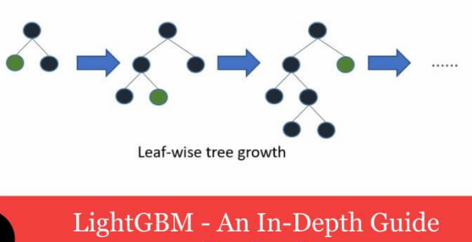
LG Boost(Light Gradient model)
LightGBM is a high-performance gradient boosting framework developed by Microsoft. It’s designed to be:
Fast and efficient
Accurate and scalable
Memory-optimized
Capable of handling large datasets

